Slide 1


Duck Workshop
https://bit.ly/2JQGDr3

Slide 2
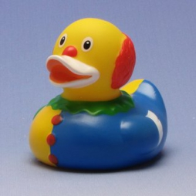
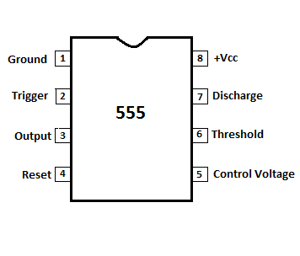
Hecking 555 timers. How do they work?
Three modes of operation:
Astable mode – Works like a clock
Monostable mode – Generates single pulses, PWM
Bistable mode – Works similar to a flip-flop
Operate between 5 and 18 Volts
CMOS versions run at lower voltages >2v
This workshop uses a CMOS 555 timer (TLC555)

Slide 3
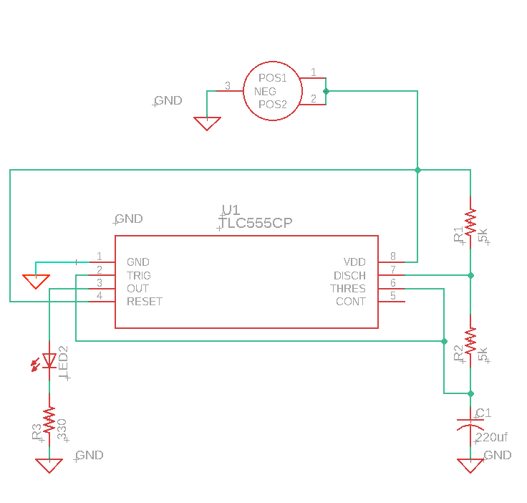
The circuit: Astable Mode
t_{on} ≈ 0.69*C1*(R1+R2)
t_{off} ≈ 0.69*C1*R2
t_{on} ≈ 1.5484 Sec
t_{off} ≈ 0.7742 Sec

Slide 4
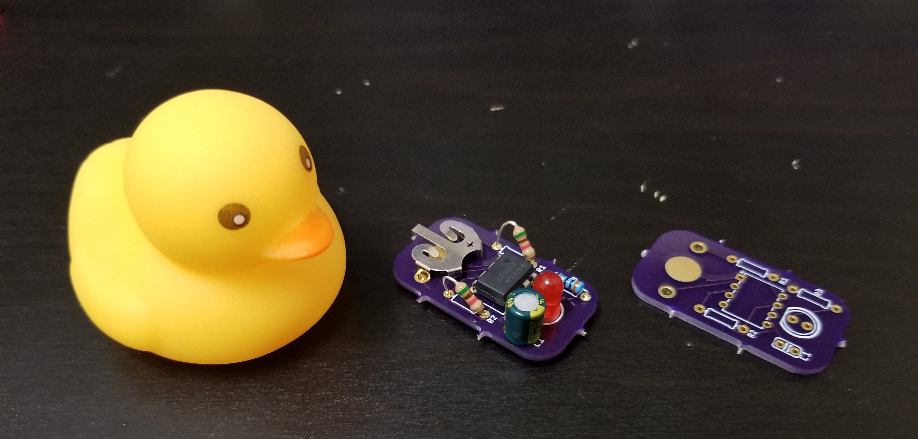
Build a duck

Slide 5
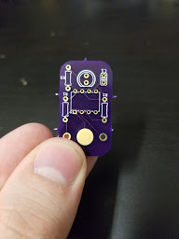
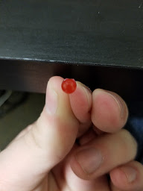
First components: LED and Capacitor
Flat part of LED matches with PCB
Negative stripe should be pointed to “C1” label as show

Slide 6
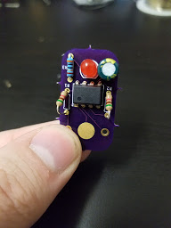
Resistors
330 Ω blue resistor (R3) goes next to LED
5.1K Ω tan resistors (R1 & R2) go on the sides
Tan resistors won’t quite fit. Angle them up (see example board)

Slide 7
555 timer
Bend pins in so they can fit in the holes
Make sure the circle shown in the photo matches your 555 timer. That’s a position indicator.

Slide 8
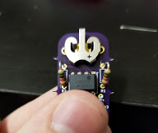
Battery holder
Pop into two holes.
Make sure orientation matches picture

Slide 9
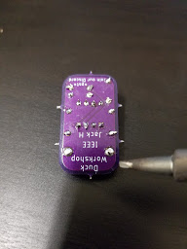
Soldering
Solder from side shown
Snip excess wire

Slide 10
Test
Insert battery.
Does it flash?

Slide 11
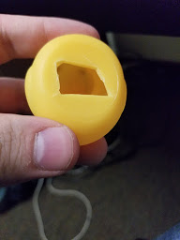
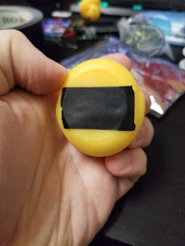
Inserting into duck
Carefully cut a hole the approximate width and height of the circuit board.
Make sure LED and capacitor are in/around the duck’s head
Seal hole with electrical tape

Slide 12
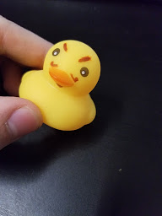
Decorate duck!

